Slide 1

Feeding the World
Transnational Poultry Value Chains:
from Georgia to the Gambia
Consulting A Group 4 :
Ruicheng Zhang
Aabha Latkar
Yueqi (Charlene) Jin
Jinhu Sun
TF:
Bui, Minh Thu

Slide 2

Client Profile
PhD student in socio-cultural anthropology
Research Interests
Development and humanitarian industries in West Africa
Current Work
Focusing on the production of chicken in the United States and its consumption in West Africa
Martin Aucoin
Source: Martin Aucoin

Slide 3

Gambia

Slide 4
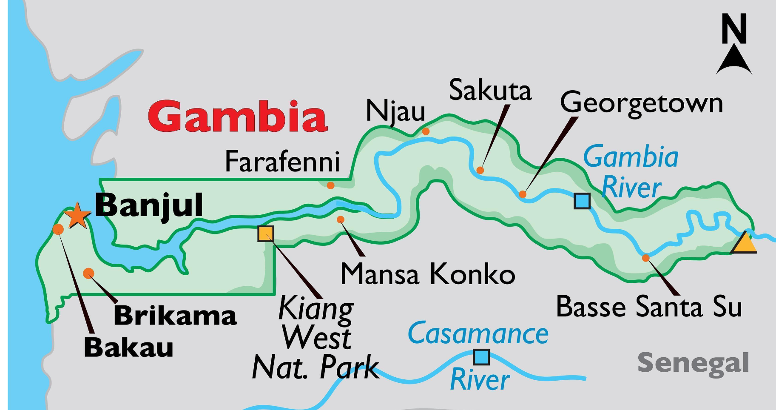
Background
A pretty significant dietary shift
Occurred in the last 20 years

Slide 5





The primary source of protein in Gambia
?
2000
2023
Local fish
Imported poultry
%
%

Slide 6



Direct cause:
The US exports large quantities of poultry (especially the chicken ) to West Africa.
Georgia
Cheaper
Gambia

Slide 7
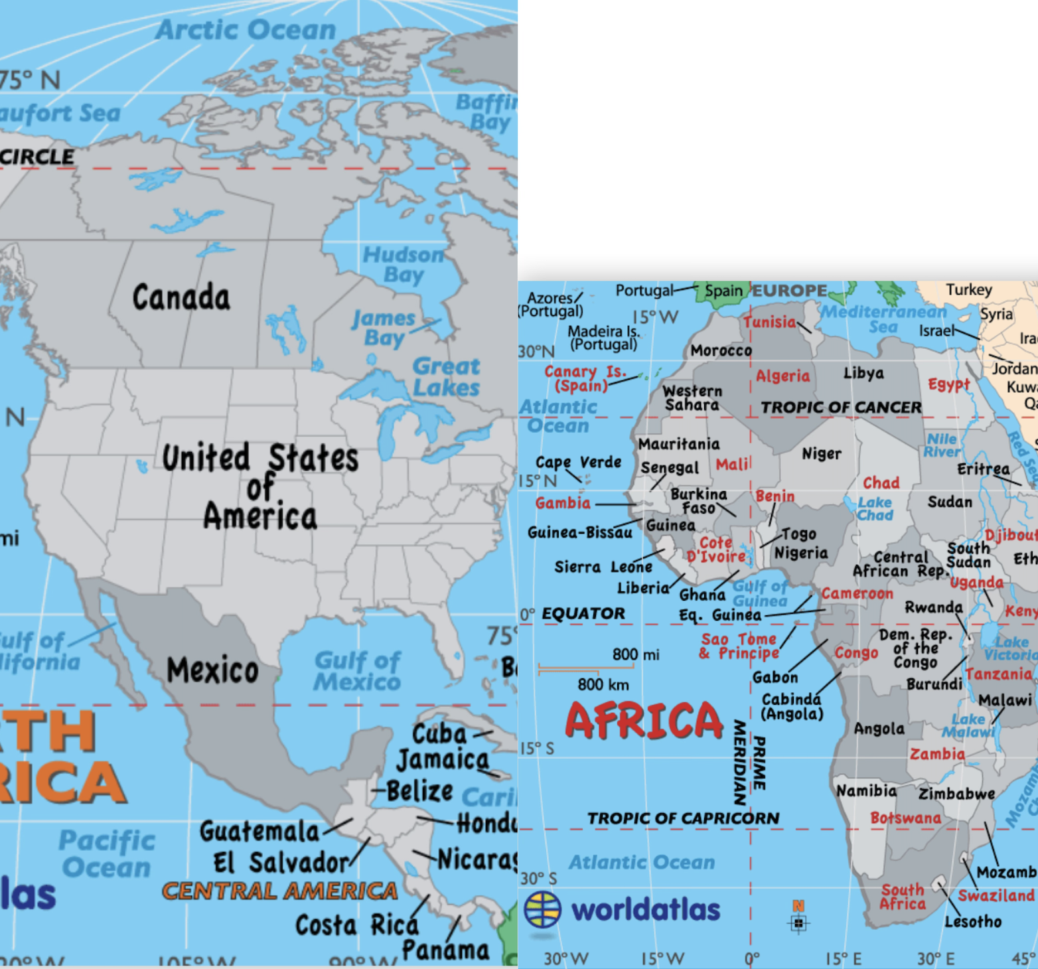
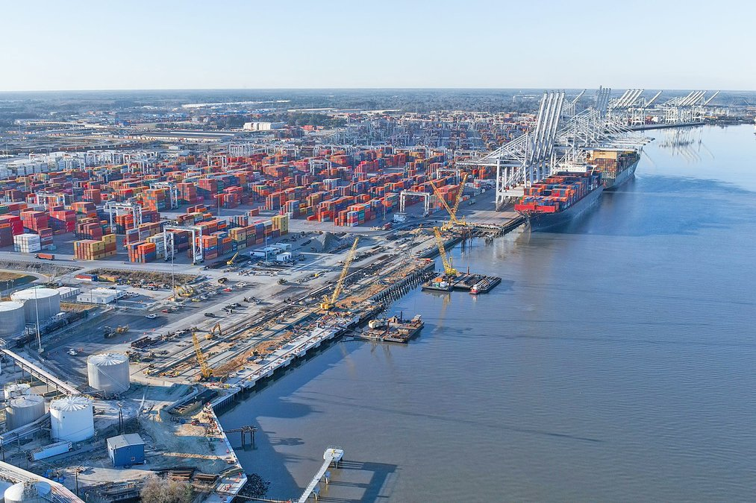
Other factors:
US and China Competition
Geopolitical narratives (system of federal agricultural subsidies)
Religious ideas, moralities
Local industries wiped out

Slide 8
Client Objectives
What Client Needs?
Translate client’s more qualitative data into quantitative data
Examine how this trade affects both Georgia and Gambia, including:
Economic effects
Cultural and moral value flows
What We Can Do?
Get data from public/private sources, including:
Trade statistics from China
Georgian poultry companies production and sales data
Gambian local industry data
Clean the data, perform EDA and visualizations for quantitative objectives
Address the client’s needs

Slide 9
Georgia and Gambia
Economic impact on both sides
Gambia:
Lower Food Prices: Gambia may benefit from lower food prices
Negative Impact on Local Producers: Gambia's local food producers might suffer
Georgia:
How is the trade affecting Georgia? Is exporting chicken legs to the Gambia profitable to the producers in Georgia? Could the recent expansion of Port Savannah be a possible indicator of this?

Slide 10
US and China Competition
Some background Client provided for us:
Chinese overseas fishing fleet.
Competition for development projects between the US Europe and China targeting different African nations.
Chicken export didn't become economically feasible until China entered the joint the WTO
Objective:
Our client wants us to test the hypothesis that the US is dumping food into the Gambia at a very
low(or no)profit margin as a means of competing with China for trading in Africa.

Slide 11
The Dataset
When:
March and April 2023
Dataset
Household Survey
Vendor Survey
42 participants
18 variables
15 variables
14 participants
Median weekly consumption: 4 kg
Average profit off of American chicken: 12%
Average weekly consumption: 4.51 kg

Slide 12
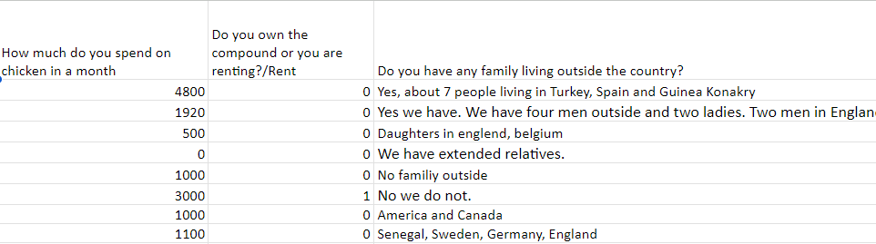
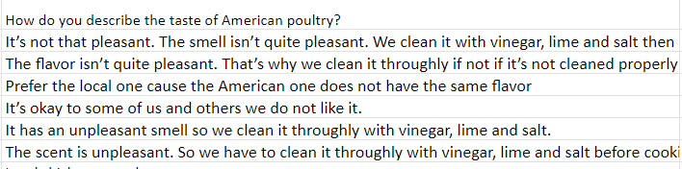
Household Survey

Slide 13
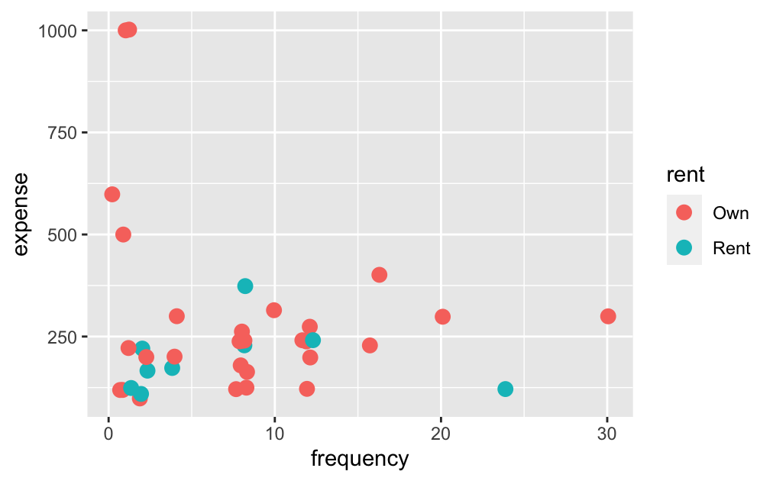
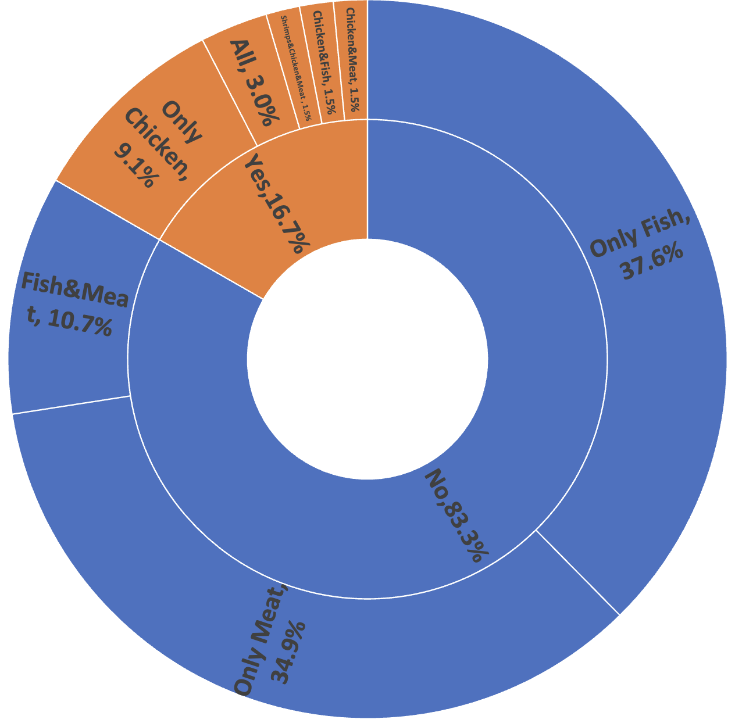
Protein preferences of the participants if they had more money.
The correlation between owning a house and expenditure on chicken.

Slide 14
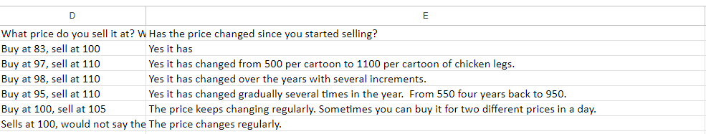
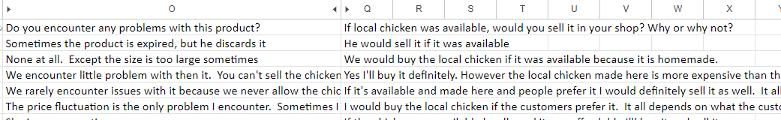
Vendor Survey

Slide 15
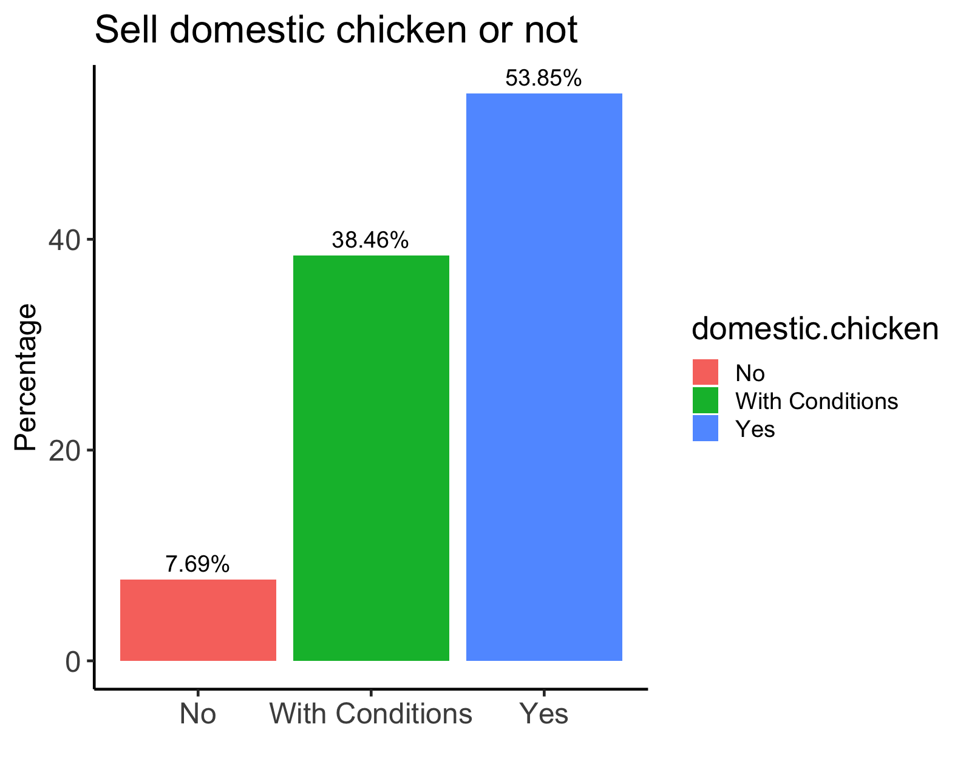
EDA of vendor survey

Slide 16
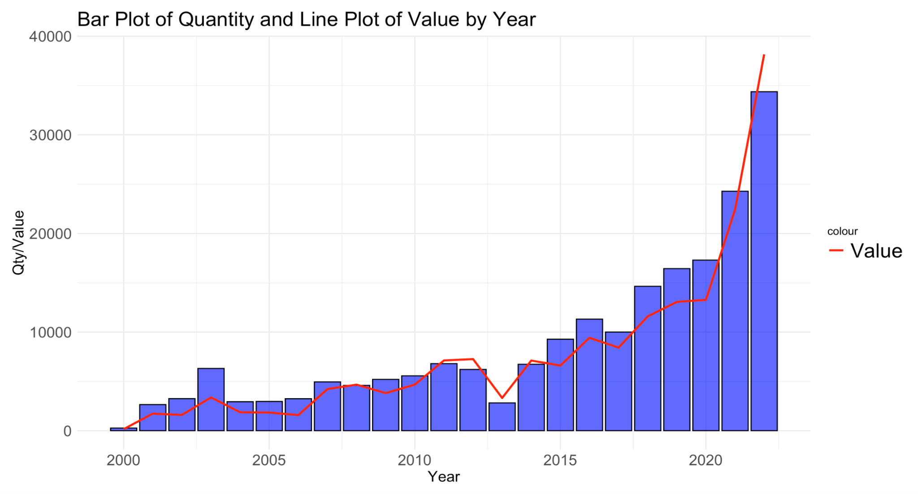
Trade data
Source: USDA/FAS GATS database

Slide 17
FUTURE PLANS
MORAL AND CULTURAL VALUES
Examine value transfers between Gambia and Georgia via calories and cost of chicken
Brainstorm possibilities for statistical analyses
Design a consumer survey in The Gambia in Winter 2023

Slide 18
Thank you!
ANY QUESTION?

Slide 19



6
Challenges
Data Acquisition
Georgian Poultry Production Company Data
Non-public Information
Corporate Secrecy Attitude
Missing Critical Data
Missing Information on Gambian Local Industry
Data Not Provided by Client
Data Nature & Sample Issues
Predominantly Qualitative Data
Small Sample Size

Slide 20
6
Future Work
Brainstorm possibilities for statistical analyses
compliment client’s more qualitative methods
Design a consumer survey to be administered in The Gambia in Winter 2023
Compare profit margins for corner vendors and poultry integrator companies
Relationship between refrigerated capacity at Port of Savannah and poultry production in Georgia/export quantity
Examine value transfers between Gambia and Georgia via calories and cost of chicken

